Slide 1

Time Domain Solutions of Telegrapher’s Equations
Farhad Rachidi
Swiss Federal Institute of Technology (EPFL)
EMC Laboratory
Farhad.Rachidi@epfl.ch
http://emc.epfl.ch

Slide 2
Time Domain Solutions
Lossless lines
A general transient solution to the telegrapher's equations (written below) cannot be obtained analytically.
However, for the special (yet practical) case of no loss on the line, these equations become

Slide 3
Time Domain Solutions
Lossless lines
General solutions to these equations consist of arbitrary functions f and g of the variables x + ct and x - ct, where . The solutions to the voltage and current are
with .
The fact that the above equations are the required solutions can be verified by substitution. Notice that the function f is a forward (+x) propagating disturbance on the line, while g is a negative propagating disturbance. The determination of the two functions f and g must be done using the source excitations and boundary conditions specific to each particular problem.

Slide 4
Time Domain Solutions
Lossless lines
A voltage signal launched on a lossless line propagates unaltered with speed v_{p} dependent on transmission line properties
+
-
x

Slide 5
Time Domain Solutions
Lossless lines
The characteristic impedance dictates the amplitude of the voltage waveform launched on the line
+
To infinity (or matched)
-

Slide 6
Time Domain Solutions
Analytical transformation from the frequency to time domain
Under certain circumstances, it is possible to develop an analytical expression for the transient response of a transmission line. Consider the finite, terminated line excited by either a voltage or a current source at an arbitrary location, x_{s}, as shown below.
As discussed earlier, explicit expressions in frequency domain can be developed for the voltage and current responses at each end of the line. The expressions for the voltage are reproduced here for convenience:
V(0) =
[- (e^{𝛾(L-xs)} - ρ₂e^{-𝛾(L-xs)})V_{o} + (e^{𝛾(L-xs)} + ρ₂e^{-𝛾(L-xs)})Z_{c}I_{o}]
V(L) =
[ (e^{𝛾xs} – ρ₁e^{-𝛾xs})V_{o} + (e^{𝛾xs} + ρ₁e^{-𝛾xs})Z_{c}I_{o}]

Slide 7
Time Domain Solutions
Analytical transformation from the frequency to time domain
In the most general case, both the propagation constant γ and the reflection coefficients of the line ρ_{i} are complex functions of frequency. However, if we assume that there are no losses on the line, and that the termination impedances are purely real, then we have the following conditions
Aside from the term (1-ρ₁ρ₂e^{-2γL}) in the denominator, all remaining terms of the equations for the current and voltage at the line ends now have only a frequency dependence of the form e^{-jωτ}, where τ is a constant. Since |ρ₁ρ₂e^{-2γL})| < 1, the denominator term may be expanded as
which also has a frequency dependence containing only factors of the form
e^{-jωτ}. Substituting the above equations into the equations for the voltages
at x = 0 and x = L, we obtain

Slide 8
Time Domain Solutions
Analytical transformation from the frequency to time domain
where the dependence on frequency of the voltage and current sources are shown explicitly.
Factors of the form e^{-jωτ} in the frequency domain amount to a shift in time in the time domain. That is to say, if a function f(t) has a Fourier transform F(ω), then the shifted spectrum e^{-jωτ}F(ω) has an inverse transform f(t-τ). This fact can be applied directly to obtain the following analytical expressions for the transient voltage responses (see next slide):

Slide 9
Time Domain Solutions
Analytical transformation from the frequency to time domain
These expressions consist of a series of non sinusoidal traveling waves, arriving at progressively later times. These correspond to multiple reflections on the transmission line. The n = 0 term is the direct contribution from the voltage source v_{o}(t) and the current source, i_{o}(t).

Slide 10
Time Domain Solutions
Analytical transformation from the frequency to time domain
Similarly, the line current at x = 0 and x = L can be found and these transient responses have the same form as the equations above, but with the leading terms (1+ρ₁) and (1+ρ₂) replaced by (1-ρ₁)/Z_{c} and (1-ρ₂)/Z_{c}, respectively. Recall that the load current at x = 0 is -I(0), while the load current at x = L is simply the line current.
As discussed by Paul (Analysis of Multiconductor Transmission Lines”, John Wiley & Sons, NY, 1994), this formalism can be applied to multiconductor lines as well, as long as there is no dispersion in the propagation constants and the loads are not functions of frequency.

Slide 11
Time Domain Solutions
Analytical transformation from the frequency to time domain
Many practical transmission line problems contain dispersion in the propagation constants or frequency dependent loads, and the direct analytical solution in the previous section cannot be used to compute the transient responses. A useful approach for obtaining transient responses in these cases is to perform calculations in the frequency-domain and then to transform the solutions into the time-domain using a numerical evaluation of the Fourier transform integral.
In doing this, the non-sinusoidal excitation (a step function, for example) is first transformed in the frequency-domain. Then, at each significant frequency contained spectrum of the excitation function, the frequency domain equations are used to determine the response spectrum. The resulting response spectrum is converted into the time-domain using an inverse FFT numerical approach.

Slide 12
Time Domain Solutions
Finite-Difference Time-Domain (FDTD) Technique
Consider a single-wire line, no frequency dependence

Slide 13
Time Domain Solutions
Finite-Difference Time-Domain (FDTD) Technique

Slide 14
Time Domain Solutions
Finite-Difference Time-Domain (FDTD) Technique

Slide 15
Time Domain Solutions
Finite-Difference Time-Domain (FDTD) Technique

Slide 16
Time Domain Solutions
Finite-Difference Time-Domain (FDTD) Technique
See Paper by C.R. Paul, 1994

Slide 17
Homework for next week

Slide 18
Time Domain Solutions
Bergeron Method
General time domain solutions to the voltage and current are
Adding and subtracting the above equations provides the following expressions for the forward and backward wave functions

Slide 19
Time Domain Solutions
Bergeron Method
In these equations, it is clear that f is constant if x - ct = constant, and that g is constant if x + ct = constant. The implication of these equations is that if a fictitious observer (called the direct Bergeron observer) moves along the line with a speed c in the forward direction, he will see that the voltage and current satisfy at each instant in time the relation
Similarly, the backward Bergeron observer (who moves in the opposite direction with respect to the first and with the same speed c will see the voltage and the current satisfying the relation

Slide 20
Time Domain Solutions
Bergeron Method
In the v-i plane representing all possible values of voltage and current, the locus of points representing what the direct observer sees corresponds to the line . For the backward observer, this is the line
Figure below shows these lines, which have the slopes equal
to -Z_{c} and +Z_{c}, respectively.
v(x,t)
Relation for backward observer
K₁
Relation for forward observer
K₂
i(x,t)

Slide 21
Time Domain Solutions
Bergeron Method
The values of the constants K₁ and K₂ can be determined using known voltage and current values in a certain point on the line and at a specified time t. For instance if the initial conditions at one of the two extremities of the line are zero at t = 0 (i.e., v =0, i = 0), the respective constant K₁ or K₂ will be equal to zero.
Numerical Application of the Bergeron method:
The numerical application of Bergeron's method is achieved by using the fact that if τ = L/c is the time of travel of a wave on a line between its origin m and its end k (see Figure below), the expression (v + Z_{c}i) seen by an observer leaving node m at time t-τ will remain the same when he arrives at node k at time t. This results in the set of equations
i_{k}
i_{m}
v_{k}
Terminal k
Terminal m
v_{m}
L
(b)

Slide 22
Time Domain Solutions
Bergeron Method
Let us define the following equivalent current sources on the line:
We can re-write the equations as

Slide 23
Time Domain Solutions
Bergeron Method
These relations permit the building of the equivalent circuit of the line shown in Figure below which fully describes the lossless line at its terminals.
The main advantage of this method compared to other approaches for solving the telegrapher's equations is that no reflection coefficients are needed.
i_{k}
i_{m}
k
m
I_{k}(t-τ)
v_{k} (t)
Z_{o}
Z_{o}
v_{m} (t)
I_{m}(t-τ)

Slide 24
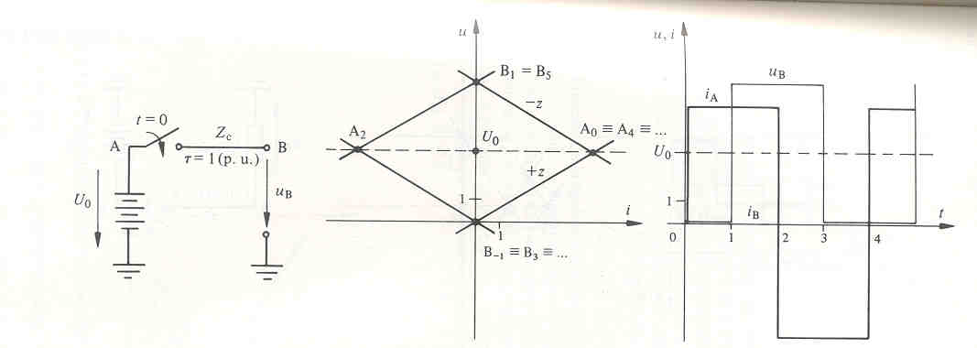
Time Domain Solutions
Bergeron Graphical Method: Example 1

Slide 25
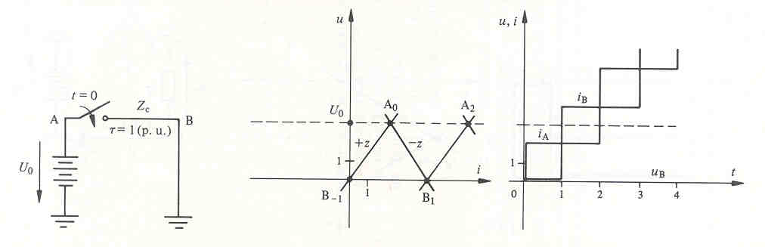
Time Domain Solutions
Bergeron Graphical Method: Example 2

Slide 26
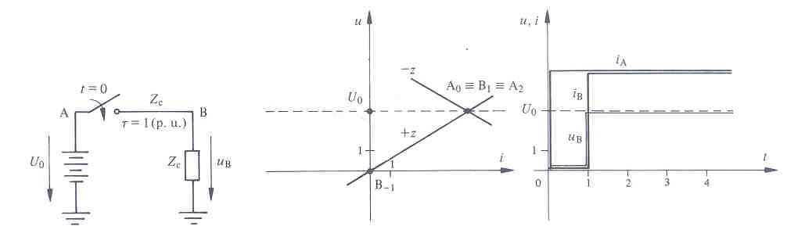
Time Domain Solutions
Bergeron Graphical Method: Example 3
(b)

Slide 27
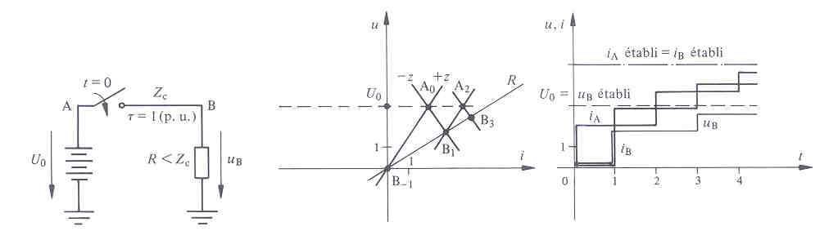
Time Domain Solutions
Bergeron Graphical Method: Example 4

Slide 28
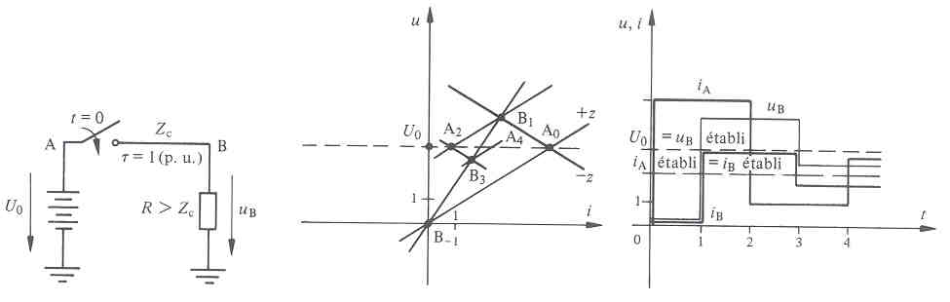
Time Domain Solutions
Bergeron Graphical Method: Example 5

Slide 29
Time Domain Solutions
Non-resistive line termination
Let us consider an incoming (incident) wave v_{i}(t) and i_{i}(t) to a line termination. We can write the following general equations
which yields
This equations supplies a relation connecting the voltage and current with the instantaneous value of the oncoming (incident) wave. The terminal condition must supply another equation ton provide the solution.

Slide 30
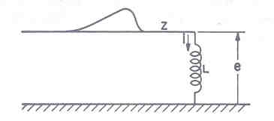
Time Domain Solutions
Line terminated on an inductance
Combining the above equations yields
If the incident voltage is a unit-step fucntion of magnitude V, the general solution for the current becomes

Slide 31
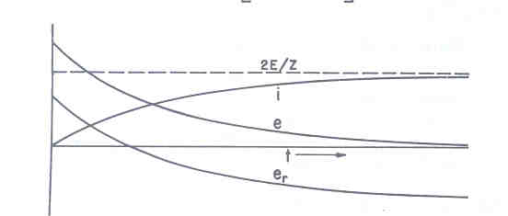
Time Domain Solutions
Line terminated on an inductance
And,

Slide 32
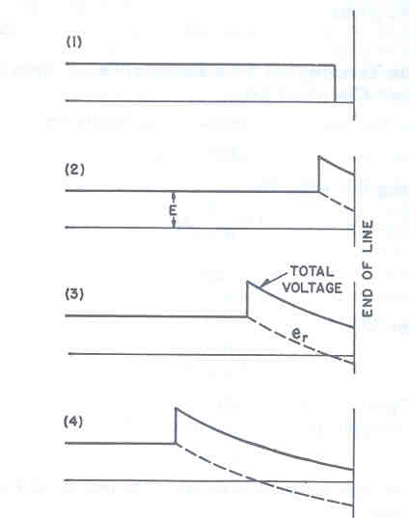
Time Domain Solutions
Line terminated on an inductance

Slide 33
Time Domain Solutions
Line terminated on a capacitance
Combining the above equations yields
If the incident voltage is a unit-step fucntion of magnitude V, the general solution for the current becomes

Slide 34
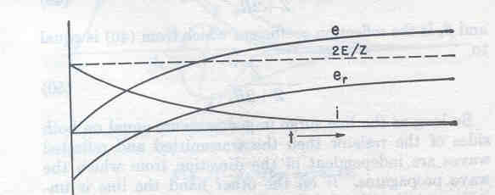
Time Domain Solutions
Line terminated on a capacitance
And,

Slide 35
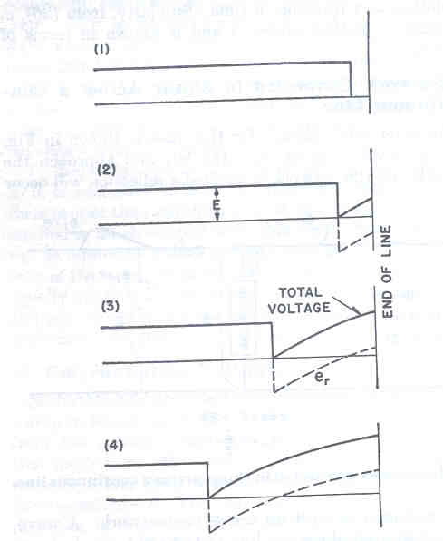
Time Domain Solutions
Line terminated on a capacitance

Slide 36
Time Domain Solutions
Shunt resistance

Slide 37
Time Domain Solutions
Shunt resistance
sum
substract

Slide 38
Examples
Mathcad, Visual Electromagnetics, Ex. 7.3
L=400 m, Z_{c} = 50 Ω, Unit-step voltage V_{s} = 100 V

Slide 39
Case 1
R_{S} = 50 Ω, R_{L} = 50 Ω

Slide 40
Case 1:
R_{S} = 50 Ω R_{L} = 50 Ω

Slide 41
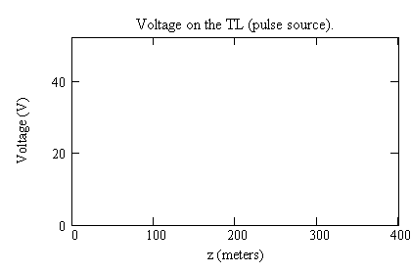
Case 1:
R_{S} = 50 Ω, R_{L} = 50 Ω

Slide 42
Case 2
R_{S} = 50 Ω, R_{L} = 0 Ω

Slide 43
Case 2:
R_{S} = 50 Ω, R_{L} = 0 Ω

Slide 44
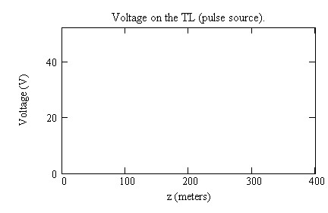
Case 2:
R_{S} = 50 Ω, R_{L} = 0 Ω

Slide 45
Case 3
R_{S} = 50 Ω, R_{L} = 1 MΩ

Slide 46
Case 3:
R_{S} = 50 Ω, R_{L} = 1 MΩ

Slide 47
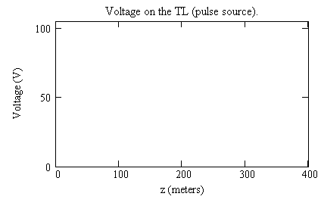
Case 3:
R_{S} = 50 Ω, R_{L} = 1 MΩ

Slide 48
Case 4: 300-km, 500 Ω long line (sinusoidal) energization, matched termination

Slide 49
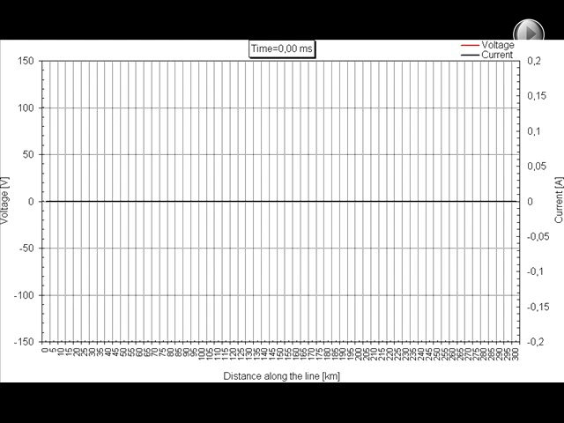
Case 4:
300-km long line (sinusoidal) energization, matched termination

Slide 50
Case 4: 300-km, 500 Ω long line (sinusoidal) energization, 300 Ω termination

Slide 51
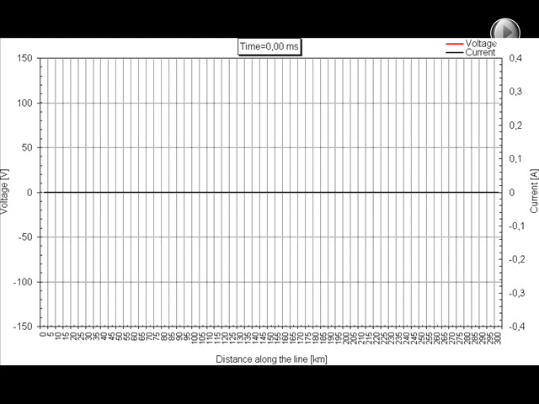

Slide 52
References and Further Reading
[1] F.M. Tesche, M. Ianoz, T. Karlsson, Emc Analysis Methods and Computational Models, Wiley, 1997.
[2] C. R. Paul, Analysis of multiconductor transmission lines. New York: John Wiley and Sons, 1994.

